Slide 1



Object-Oriented Programming with C#
Classes, Constructors, Properties, Events, Static Members, Interfaces, Inheritance, Polymorphism
Svetlin Nakov
Telerik Corporation
www.telerik.com

Slide 2

Table of Contents
Defining Classes
Access Modifiers
Constructors
Fields, Constants and Properties
Static Members
Structures
Delegates and Events
Interfaces
Inheritance
Polymorphism

Slide 3
OOP and .NET
In .NET Framework the object-oriented approach has roots in the deepest architectural level
All .NET applications are object-oriented
All .NET languages are object-oriented
The class concept from OOP has two realizations:
Classes and structures
There is no multiple inheritance in .NET
Classes can implement several interfaces at the same time

Slide 4
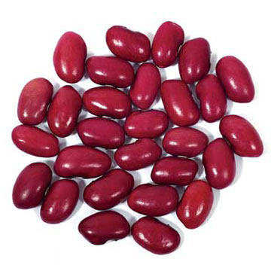
Defining Classes

Slide 5
Classes in OOP
Classes model real-world objects and define
Attributes (state, properties, fields)
Behavior (methods, operations)
Classes describe structure of objects
Objects describe particular instance of a class
Properties hold information about the modeled object relevant to the problem
Operations implement object behavior

Slide 6
Classes in C#
Classes in C# could have following members:
Fields, constants, methods, properties, indexers, events, operators, constructors, destructors
Inner types (inner classes, structures, interfaces, delegates, ...)
Members can have access modifiers (scope)
public, private, protected, internal
Members can be
static (common) or specific for a given object

Slide 7
Simple Class Definition
Begin of class definition
public class Cat : Animal {
private string name;
private string owner;
public Cat(string name, string owner)
{
this.name = name;
this.owner = owner;
}
public string Name
{
get { return name; }
set { name = value; }
}
Inherited (base) class
Fields
Constructor
Property

Slide 8

Simple Class Definition (2)
public string Owner
{
get { return owner;}
set { owner = value; }
}
public void SayMiau()
{
Console.WriteLine("Miauuuuuuu!");
}
}
Method
End of class definition

Slide 9
Classes and Their Members
Classes have members
Fields, constants, methods, properties, indexers, events, operators, constructors, destructors
Inner types (inner classes, structures, interfaces, delegates, ...)
Members have modifiers (scope)
public, private, protected, internal
Members can be
static (common) or for a given type

Slide 10

Class Definition and Members
Class definition consists of:
Class declaration
Inherited class or implemented interfaces
Fields (static or not)
Constructors (static or not)
Properties (static or not)
Methods (static or not)
Events, inner types, etc.

Slide 11


Access Modifiers
Public, Private, Protected, Internal

Slide 12
Access Modifiers
Class members can have access modifiers
Used to restrict the classes able to access them
Supports the OOP principle "encapsulation"
Class members can be:
public – accessible from any class
protected – accessible from the class itself and all its descendent classes
private – accessible from the class itself only
internal – accessible from the current assembly (used by default)

Slide 13
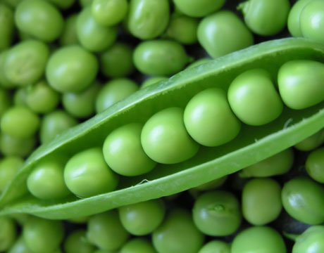
Defining Classes
Example

Slide 14
Task: Define Class Dog
Our task is to define a simple class that represents information about a dog
The dog should have name and breed
If there is no name or breed assigned to the dog, it should be named "Balkan" and its breed should be "Street excellent"
It should be able to view and change the name and the breed of the dog
The dog should be able to bark
Notes:
Mew = мяукам!

Slide 15

Defining Class Dog – Example
public class Dog {
private string name;
private string breed;
public Dog()
{
this.name = "Balkan";
this.breed = "Street excellent";
}
public Dog(string name, string breed)
{
this.name = name;
this.breed = breed;
}
//(example continues)

Slide 16

Defining Class Dog – Example (2)
public string Name
{
get { return name; }
set { name = value; }
}
public string Breed
{
get { return breed; }
set { breed = value; }
}
public void SayBau()
{
Console.WriteLine("{0} said: Bauuuuuu!", name);
}
}

Slide 17

Using Classes and Objects

Slide 18

Using Classes
How to use classes?
Create a new instance
Access the properties of the class
Invoke methods
Handle events
How to define classes?
Create new class and define its members
Create new class using some other as base class

Slide 19
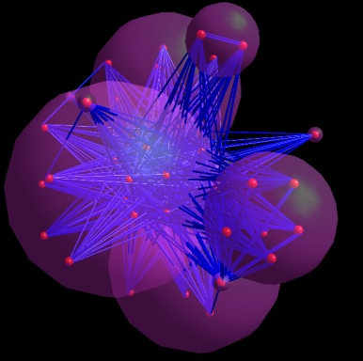
How to Use Classes (Non-static)?
Create an instance
Initialize fields
Manipulate instance
Read / change properties
Invoke methods
Handle events
Release occupied resources
Done automatically in most cases

Slide 20
Task: Dog Meeting
Our task is as follows:
Create 3 dogs
First should be named “Sharo”, second – “Rex” and the last – left without name
Add all dogs in an array
Iterate through the array elements and ask each dog to bark
Note:
Use the Dog class from the previous example!

Slide 21
Dog Meeting – Example
static void Main()
{
Console.WriteLine("Enter first dog's name: ");
dogName = Console.ReadLine();
Console.WriteLine("Enter first dog's breed: ");
dogBreed = Console.ReadLine();
// Using the Dog constructor to set name and breed
Dog firstDog = new Dog(dogName, dogBreed);
Dog secondDog = new Dog();
Console.WriteLine("Enter second dog's name: ");
dogName = Console.ReadLine();
Console.WriteLine("Enter second dog's breed: ");
dogBreed = Console.ReadLine();
// Using properties to set name and breed
secondDog.Name = dogName;
secondDog.Breed = dogBreed;
}

Slide 22
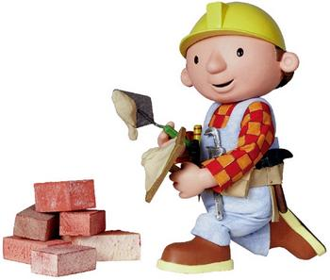
Constructors
Defining and Using Class Constructors

Slide 23
What is Constructor?
Constructors are special methods
Invoked when creating a new instance of an object
Used to initialize the fields of the instance
Constructors has the same name as the class
Have no return type
Can have parameters
Can be private, protected, internal, public

Slide 24

Defining Constructors
Class Point with parameterless constructor:
public class Point
{
private int xCoord;
private int yCoord;
// Simple default constructor
public Point()
{
xCoord = 0;
yCoord = 0;
}
// More code ...
}

Slide 25
Defining Constructors (2)
public class Person
{
private string name;
private int age;
// Default constructor
public Person()
{
name = "[no name]";
age = 0;
}
// Constructor with parameters
public Person(string name, int age)
{
this.name = name;
this.age = age;
}
// More code ...
}
As rule constructors should initialize all own class fields.

Slide 26
Constructors and Initialization
Pay attention when using inline initialization!
public class ClockAlarm
{
private int hours = 9; // Inline initialization
private int minutes = 0; // Inline initialization
// Default constructor
public ClockAlarm()
{ }
// Constructor with parameters
public ClockAlarm(int hours, int minutes)
{
this.hours = hours; // Invoked after the inline
this.minutes = minutes; // initialization!
}
// More code ...
}

Slide 27

Chaining Constructors Calls
Reusing constructors
public class Point
{
private int xCoord;
private int yCoord;
public Point() : this(0,0) // Reuse constructor
{
}
public Point(int xCoord, int yCoord)
{
this.xCoord = xCoord;
this.yCoord = yCoord;
}
// More code ...
}

Slide 28
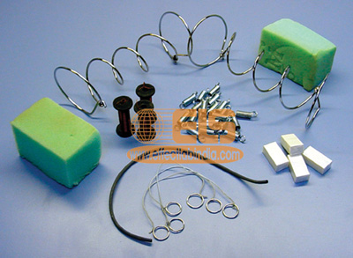
Fields, Constants and and Properties

Slide 29
Fields
Fields contain data for the class instance
Can be arbitrary type
Have given scope
Can be declared with a specific value
class Student
{
private string firstName;
private string lastName;
private int course = 1;
private string speciality;
protected Course[] coursesTaken;
private string remarks = "(no remarks)";
}

Slide 30
Constants
Constant fields are defined like fields, but:
Defined with const
Must be initialized at their definition
Their value can not be changed at runtime
public class MathConstants
{
public const string PI_SYMBOL = "π";
public const double PI = 3.1415926535897932385;
public const double E = 2.7182818284590452354;
public const double LN10 = 2.30258509299405;
public const double LN2 = 0.693147180559945;
}

Slide 31
Read-Only Fields
Initialized at the definition or in the constructor
Can not be modified further
Defined with the keyword readonly
Represent runtime constants
public class ReadOnlyDemo
{
private readonly int size;
public ReadOnlyDemo(int Size)
{
size = Size; // can not be further modified!
}
}

Slide 32
The Role of Properties
Expose object's data to the outside world
Control how the data is manipulated
Properties can be:
Read-only
Write-only
Read and write
Give good level of abstraction
Make writing code easier

Slide 33
Defining Properties in C#
Properties should have:
Access modifier (public, protected, etc.)
Return type
Unique name
Get and / or Set part
Can contain code processing data in specific way

Slide 34
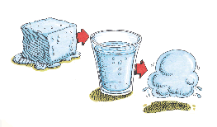
Defining Properties – Example
public class Point
{
private int xCoord;
private int yCoord;
public int XCoord
{
get { return xCoord; }
set { xCoord = value; }
}
public int YCoord
{
get { return yCoord; }
set { yCoord = value; }
}
// More code ...
}

Slide 35
Dynamic Properties
Properties are not obligatory bound to a class field – can be calculated dynamically:
public class Rectangle
{
private float width;
private float height;
// More code ...
public float Area
{
get
{
return width * height;
}
}
}

Slide 36
Automatic Properties
Properties could be defined without an underlying field behind them
It is automatically created by the C# compiler
class UserProfile
{
public int UserId { get; set; }
public string FirstName { get; set; }
public string LastName { get; set; }
}
…
UserProfile profile = new UserProfile() {
FirstName = "Steve",
LastName = "Balmer",
UserId = 91112 };

Slide 37

Static Members
Static vs. Instance Members

Slide 38

Static Members
Static members are associated with a type rather than with an instance
Defined with the modifier static
Static can be used for
Fields
Properties
Methods
Events
Constructors

Slide 39
Static vs. Non-Static
Static:
Associated with a type, not with an instance
Non-Static:
The opposite, associated with an instance
Static:
Initialized just before the type is used for the first time
Non-Static:
Initialized when the constructor is called

Slide 40

Static Members – Example
public class SqrtPrecalculated
{
public const int MAX_VALUE = 10000;
// Static field
private static int[] sqrtValues;
// Static constructor
private static SqrtPrecalculated()
{
sqrtValues = new int[MAX_VALUE + 1];
for (int i = 0; i < sqrtValues.Length; i++)
{
sqrtValues[i] = (int)Math.Sqrt(i);
}
}
//(example continues)

Slide 41

Static Members – Example (2)
// Static method
public static int GetSqrt(int value)
{
return sqrtValues[value];
}
// The Main() method is always static
static void Main()
{
Console.WriteLine(GetSqrt(254));
}
}

Slide 42

Structures

Slide 43
Structures
Structures represent a combination of fields with data
Look like the classes, but are value types
Their content is stored in the stack
Transmitted by value
Destroyed when go out of scope
However classes are reference type and are placed in the dynamic memory (heap)
Their creation and destruction is slower

Slide 44
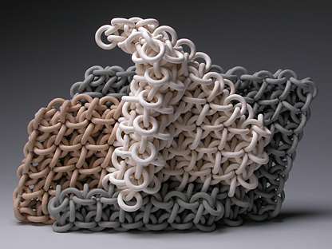
Structures – Example
struct Point
{
public int X, Y;
}
struct Color
{
public byte redValue;
public byte greenValue;
public byte blueValue;
}
struct Square
{
public Point location;
public int size;
public Color borderColor;
public Color surfaceColor;
}

Slide 45
When to Use Structures?
Use structures
To make your type behave as a primitive type
If you create many instances and after that you free them – e.g. in a cycle
Do not use structures
When you often transmit your instances as method parameters
If you use collections without generics (too much boxing / unboxing!)

Slide 46

Delegates and Events

Slide 47
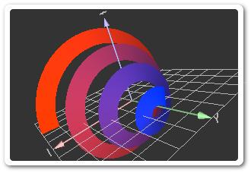
What are Delegates?
Delegates are reference types
Describe the signature of a given method
Number and types of the parameters
The return type
Their "values" are methods
These methods correspond to the signature of the delegate

Slide 48

What are Delegates? (2)
Delegates are roughly similar to function pointers in C and C++
Contain a strongly-typed pointer (reference) to a method
They can point to both static or instance methods
Used to perform callbacks

Slide 49
Delegates – Example
// Declaration of a delegate
public delegate void SimpleDelegate(string param);
public class TestDelegate
{
public static void TestFunction(string param)
{
Console.WriteLine("I was called by a delegate.");
Console.WriteLine("I got parameter {0}.", param);
}
public static void Main()
{
// Instantiation of а delegate
SimpleDelegate simpleDelegate =
new SimpleDelegate(TestFunction);
// Invocation of the method, pointed by a delegate
simpleDelegate("test");
}
}

Slide 50

Anonymous Methods
We are sometimes forced to create a class or a method just for the sake of using a delegate
The code involved is often relatively short and simple
Anonymous methods let you define an nameless method called by a delegate
Less coding
Improved code readability

Slide 51
Using Delegates: Standard Way
class SomeClass
{
delegate void SomeDelegate(string str);
public void InvokeMethod()
{
SomeDelegate dlg = new SomeDelegate(SomeMethod);
dlg("Hello");
}
void SomeMethod(string str)
{
Console.WriteLine(str);
}
}

Slide 52
Using Anonymous Methods
The same thing can be accomplished by using an anonymous method:
class SomeClass
{
delegate void SomeDelegate(string str);
public void InvokeMethod()
{
SomeDelegate dlg = delegate(string str)
{
Console.WriteLine(str);
};
dlg("Hello");
}
}

Slide 53
Events
In component-oriented programming the components send events to their owner to notify them when something happens
E.g. when a button is pressed an event is raised
The object which causes an event is called event sender
The object which receives an event is called event receiver
In order to be able to receive an event the event receivers must first "subscribe for the event"

Slide 54
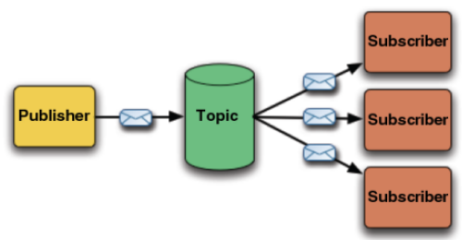
Events in .NET
In the component model of .NET Framework delegates and events provide mechanism for:
Subscription to an event
Sending an event
Receiving an event
Events in C# are special instances of delegates declared by the C# keyword event
Example (Button.Click):
public event EventHandler Click;

Slide 55
Events in .NET (2)
The C# compiler automatically defines the += and -= operators for events
+= subscribe for an event
-= unsubscribe for an event
There are no other allowed operations
Example:
Button button = new Button("OK");
button.Click += delegate
{
Console.WriteLine("Button clicked.");
};

Slide 56
Events vs. Delegates
Events are not the same as member fields of type delegate
The event is processed by a delegate
Events can be members of an interface unlike delegates
Calling of an event can only be done in the class it is defined in
By default the access to the events is synchronized (thread-safe)
public MyDelegate m;
≠
public event MyDelegate m;

Slide 57
System.EventHandler Delegate
Defines a reference to a callback method, which handles events
No additional information is sent
Used in many occasions internally in .NET
E.g. in ASP.NET and Windows Forms
The EventArgs class is base class with no information about the event
Sometimes delegates derive from it
public delegate void EventHandler(
Object sender, EventArgs e);

Slide 58
EventHandler – Example
public class Button
{
public event EventHandler Click;
public event EventHandler GotFocus;
public event EventHandler TextChanged;
...
}
public class ButtonTest
{
private static void Button_Click(object sender,
EventArgs eventArgs)
{
Console.WriteLine("Call Button_Click() event");
}
public static void Main()
{
Button button = new Button();
button.Click += Button_Click;
}
}

Slide 59
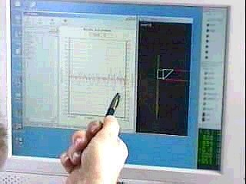
Interfaces and Abstract Classes

Slide 60
Interfaces
Describe a group of methods (operations), properties and events
Can be implemented by given class or structure
Define only the methods’ prototypes
No concrete implementation
Can be used to define abstract data types
Can not be instantiated
Members do not have scope modifier and by default the scope is public

Slide 61

Interfaces – Example
public interface IPerson
{
string Name // property Name
{ get; set; }
DateTime DateOfBirth // property DateOfBirth
{ get; set; }
int Age // property Age (read-only)
{ get; }
}

Slide 62
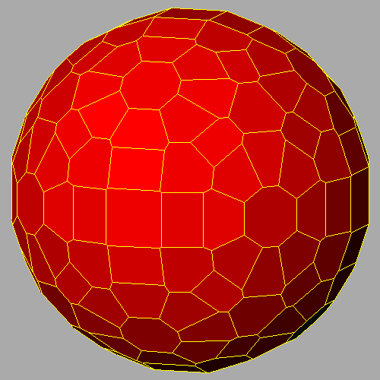
Interfaces – Example (2)
interface IShape
{
void SetPosition(int x, int y);
int CalculateSurface();
}
interface IMovable
{
void Move(int deltaX, int deltaY);
}
interface IResizable
{
void Resize(int weight);
void Resize(int weightX, int weightY);
void ResizeByX(int weightX);
void ResizeByY(int weightY);
}

Slide 63
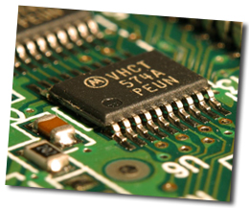
Interface Implementation
Classes and structures can implement (support) one or many interfaces
Interface realization must implement all its methods
If some methods do not have implementation the class or structure have to be declared as an abstract

Slide 64
Interface Implementation – Example
class Rectangle : IShape, IMovable
{
private int x, y, width, height;
public void SetPosition(int x, int y) // IShape
{
this.x = x;
this.y = y;
}
public int CalculateSurface() // IShape
{
return this.width * this.height;
}
public void Move(int deltaX, int deltaY) // IMovable
{
this.x += deltaX;
this.y += deltaY;
}
}

Slide 65

Abstract Classes
Abstract method is a method without implementation
Left empty to be implemented by descendant classes
When a class contains at least one abstract method, it is called abstract class
Mix between class and interface
Inheritors are obligated to implement their abstract methods
Can not be directly instantiated

Slide 66
Abstract Class – Example
abstract class MovableShape : IShape, IMovable
{
private int x, y;
public void Move(int deltaX, int deltaY)
{
this.x += deltaX;
this.y += deltaY;
}
public void SetPosition(int x, int y)
{
this.x = x;
this.y = y;
}
public abstract int CalculateSurface();
}

Slide 67
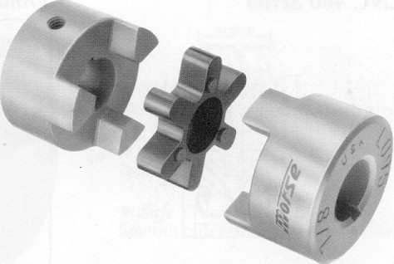
Cohesion and Coupling

Slide 68
Cohesion
Cohesion describes how closely all the routines in a class or all the code in a routine support a central purpose
Cohesion must be strong
Classes must contain strongly related functionality and aim for single purpose
Cohesion is a useful tool for managing complexity
Well-defined abstractions keep cohesion strong

Slide 69


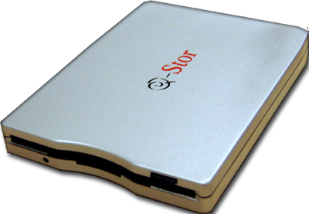
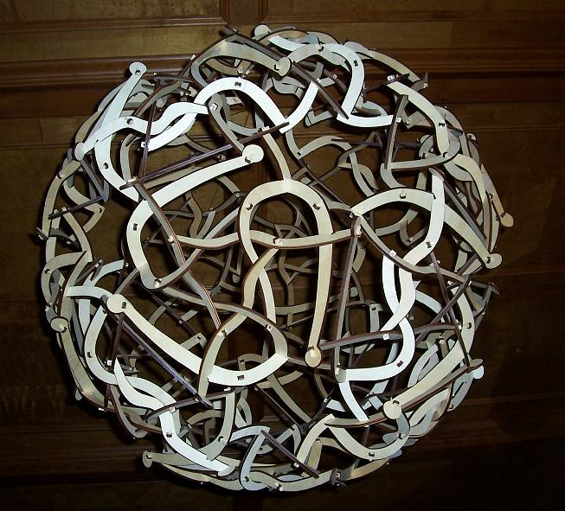
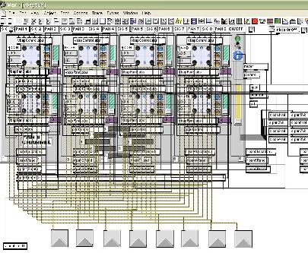
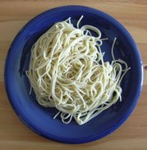

Good and Bad Cohesion
Good cohesion: hard disk, CD-ROM, floppy
BAD: spaghetti code

Slide 70
Strong Cohesion
Strong cohesion example
Class Math that has methods:
Sin(), Cos(), Asin(), Sqrt(), Pow(), Exp()
Math.PI, Math.E
double sideA = 40, sideB = 69;
double angleAB = Math.PI / 3;
double sideC =
Math.Pow(sideA, 2) + Math.Pow(sideB, 2)
- 2 * sideA * sideB * Math.Cos(angleAB);
double sidesSqrtSum = Math.Sqrt(sideA) + Math.Sqrt(sideB) + Math.Sqrt(sideC);

Slide 71
Bad Cohesion
Example of bad cohesion
Class Magic that has all these methods:
Another example:
public void PrintDocument(Document d);
public void SendEmail(string recipient, string subject, string text);
public void CalculateDistanceBetweenPoints(int x1, int y1, int x2, int y2)
MagicClass.MakePizza("Fat Pepperoni");
MagicClass.WithdrawMoney("999e6");
MagicClass.OpenDBConnection();

Slide 72
Coupling
Coupling describes how tightly a class or routine is related to other classes or routines
Coupling must be kept loose
Modules must depend little on each other
All classes and routines must have small, direct, visible, and flexible relations to other classes and routines
One module must be easily used by other modules

Slide 73
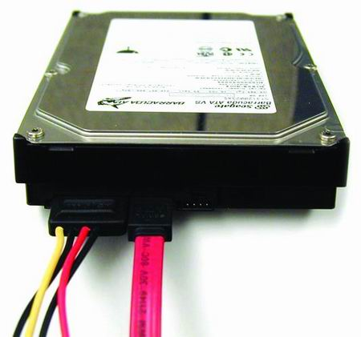
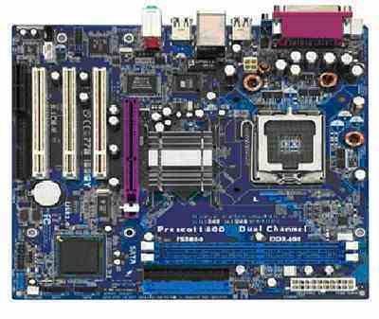
Loose and Tight Coupling
Loose Coupling:
Easily replace old HDD
Easily place this HDD to another motherboard
Tight Coupling:
Where is the video adapter?
Can you change the video controller?

Slide 74
Loose Coupling – Example
class Report
{
public bool LoadFromFile(string fileName) {…}
public bool SaveToFile(string fileName) {…}
}
class Printer
{
public static int Print(Report report) {…}
}
class LooseCouplingExample
{
static void Main()
{
Report myReport = new Report();
myReport.LoadFromFile("C:\\DailyReport.rep");
Printer.Print(myReport);
}
}

Slide 75
Tight Coupling – Example
class MathParams
{
public static double operand;
public static double result;
}
class MathUtil
{
public static void Sqrt()
{
MathParams.result = CalcSqrt(MathParams.operand);
}
}
class Example
{
static void Main()
{
MathParams.operand = 64;
MathUtil.Sqrt();
Console.WriteLine(MathParams.result);
}
}

Slide 76
Spaghetti Code
Combination of bad cohesion and tight coupling
class Report
{
public void Print() {…}
public void InitPrinter() {…}
public void LoadPrinterDriver(string fileName) {…}
public bool SaveReport(string fileName) {…}
public void SetPrinter(string printer) {…}
}
class Printer
{
public void SetFileName() {…}
public static bool LoadReport() {…}
public static bool CheckReport() {…}
}

Slide 77
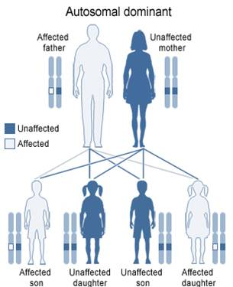
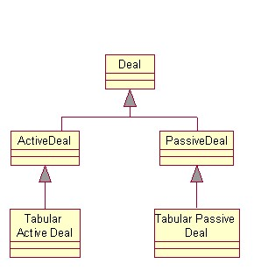
Inheritance

Slide 78
Inheritance
Inheritance is the ability of a class to implicitly gain all members from another class
Inheritance is fundamental concept in OOP
The class whose methods are inherited is called base (parent) class
The class that gains new functionality is called derived (child) class
Inheritance establishes an is-a relationship between classes: A is B

Slide 79
Inheritance (2)
All class members are inherited
Fields, methods, properties, …
In C# classes could be inherited
The structures in C# could not be inherited
Inheritance allows creating deep inheritance hierarchies
In .NET there is no multiple inheritance, except when implementing interfaces

Slide 80
How to Define Inheritance?
We must specify the name of the base class after the name of the derived
In the constructor of the derived class we use the keyword base to invoke the constructor of the base class
public class Shape
{...}
public class Circle : Shape
{...}
public Circle (int x, int y) : base(x)
{...}

Slide 81

Inheritance – Example
public class Mammal
{
private int age;
public Mammal(int age)
{
this.age = age;
}
public int Age
{
get { return age; }
set { age = value; }
}
public void Sleep()
{
Console.WriteLine("Shhh! I'm sleeping!");
}
}

Slide 82

Inheritance – Example (2)
public class Dog : Mammal
{
private string breed;
public Dog(int age, string breed): base(age)
{
this.breed = breed;
}
public string Breed
{
get { return breed; }
set { breed = value; }
}
public void WagTail()
{
Console.WriteLine("Tail wagging...");
}
}

Slide 83

Inheritance – Example (3)
static void Main()
{
// Create 5 years old mammal
Mamal mamal = new Mamal(5);
Console.WriteLine(mamal.Age);
mamal.Sleep();
// Create a bulldog, 3 years old
Dog dog = new Dog("Bulldog", 3);
dog.Sleep();
dog.Age = 4;
Console.WriteLine("Age: {0}", dog.Age);
Console.WriteLine("Breed: {0}", dog.Breed);
dog.WagTail();
}

Slide 84
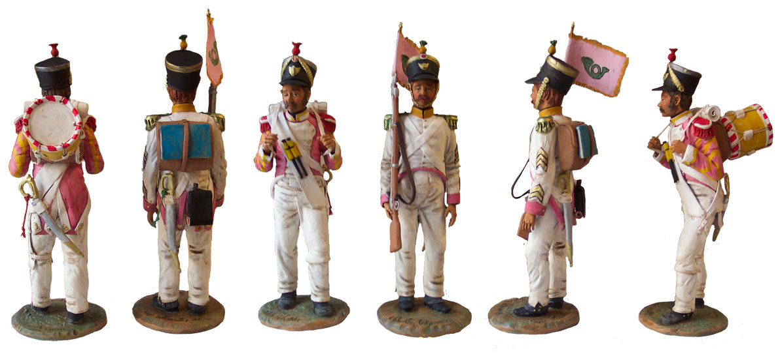
Polymorphism

Slide 85
Polymorphism
Polymorphism is fundamental concept in OOP
The ability to handle the objects of a specific class as instances of its parent class and to call abstract functionality
Polymorphism allows creating hierarchies with more valuable logical structure
Allows invoking abstract functionality without caring how and where it is implemented

Slide 86
Polymorphism (2)
Polymorphism is usually implemented through:
Virtual methods (virtual)
Abstract methods (abstract)
Methods from an interface (interface)
In C# to override virtual method the keyword override is used
C# allows hiding virtual methods in derived classes by the keyword new

Slide 87

Polymorphism – Example
class Person
{
public virtual void PrintName()
{
Console.WriteLine("I am a person.");
}
}
class Trainer : Person
{
public override void PrintName()
{
Console.WriteLine("I am a trainer.");
}
}
class Student : Person
{
public override void PrintName()
{
Console.WriteLine("I am a student.");
}
}

Slide 88
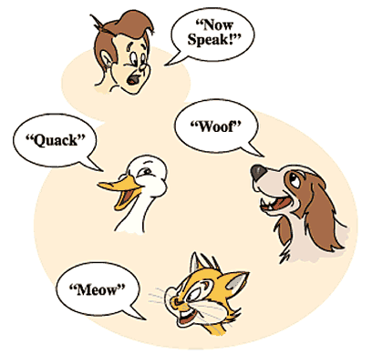
Polymorphism – Example (2)
static void Main()
{
Person[] persons =
{
new Person(),
new Trainer(),
new Student()
};
foreach (Person p in persons)
{
Console.WriteLine(p);
}
// I am a person.
// I am a trainer.
// I am a student.
}

Slide 89
Homework
We are given a school. In the school there are classes of students. Each class has a set of teachers. Each teacher teaches a set of disciplines. Students have name and unique class number. Classes have unique text identifier. Teachers have name. Disciplines have name, number of lectures and number of exercises. Both teachers and students are people.
Your task is to identify the classes (in terms of OOP) and their attributes and operations, define the class hierarchy.
89

Slide 90
Homework (2)
Define class Human with first name and last name. Define new class Student which is derived from Human and has new field – grade. Define class Worker derived from Human with new field weekSalary and work-hours per day and method MoneyPerHour() that returns money earned by hour by the worker. Define the proper constructors and properties for this hierarchy. Initialize an array of 10 students and sort them by grade in ascending order. Initialize an array of 10 workers and sort them by money per hour in descending order.
90

Slide 91
Homework (3)
Define abstract class Shape with only one abstract method CalculateSurface() and fields width and height. Define two new classes Triangle and Rectangle that implement the virtual method and return the surface of the figure (height*width for rectangle and height*width/2 for triangle). Define class Circle and suitable constructor so that on initialization height must be kept equal to width and implement the CalculateSurface() method. Write a program that tests the behavior of the CalculateSurface() method for different shapes (Circle, Rectangle, Triangle) stored in an array.
91

Slide 92
Homework (4)
Create a hierarchy Dog, Frog, Cat, Kitten, Tomcat and define suitable constructors and methods according to the following rules: all of this are Animals. Kittens and tomcats are cats. All animals are described by age, name and sex. Kittens can be only female and tomcats can be only male. Each animal produce a sound. Create arrays of different kinds of animals and calculate the average age of each kind of animal using static methods. Create static method in the animal class that identifies the animal by its sound.
92

Slide 93

Object-Oriented Programming with C#
Questions?
?
?
?
?

